Slide 1
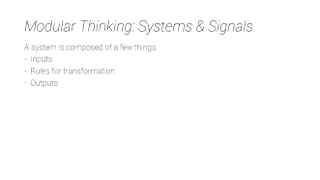
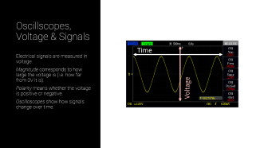
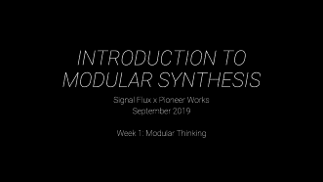
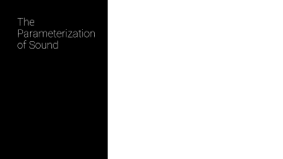
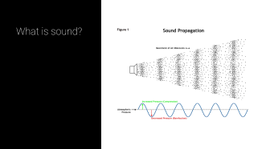
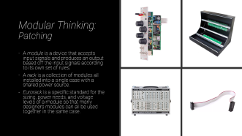
Week 1: Modular Thinking

Slide 2
INTRODUCTION TO MODULAR SYNTHESIS
Signal Flux x Pioneer Works
September 2019
Week 1: Modular Thinking

Slide 3
Agenda
Introductions
Course Overview
Modular Thinking
The Parameters of Sound
The Electronic Transmission of Sound
So What's a Patch?
Control Voltage and Modulation
Modular Building Blocks
Oscilloscopes: Visualizing Voltage
Oscillators: Frequency and Amplitude
Attenuators and Voltage-Controlled Amplifiers: Amplitude Control
Break
Lab: Introduction to VCV Rack

Slide 4
Course Overview: Topics
Week 1: Introduction to Modular Thinking – VCOs, VCAs
Week 2: Creating Events – Gates, Triggers, EGs, V/Oct, Sequencers, Mixers
Week 3: Sculpting Timbre & Time – VCFs, Pattern Generators, Chance, FX
Week 4:The Real World – Interfacing, Planning a Case, Creative Practice

Slide 5
Course Overview: Learning Goals
Understanding discrete modular building blocks
Understanding control voltage and modulation
Ability to build and analyze relationships in a patch from scratch
Ability to think on the micro-, meso-, and macro-timescales of composition
Self-sufficiently be able to continue your learning and modular practice

Slide 6
Course Overview: Class Structure
Each class we will:
- Review homework
- Lecture & demo of new concepts using hardware modular synthesizers
Explore new concepts in guided labs within VCV Rack
Opportunities for hands-on practice with 4MS Pods

Slide 7
Modular Thinking: Systems & Signals
A system is composed of a few things:
Inputs
Rules for transformation
Outputs

Slide 8
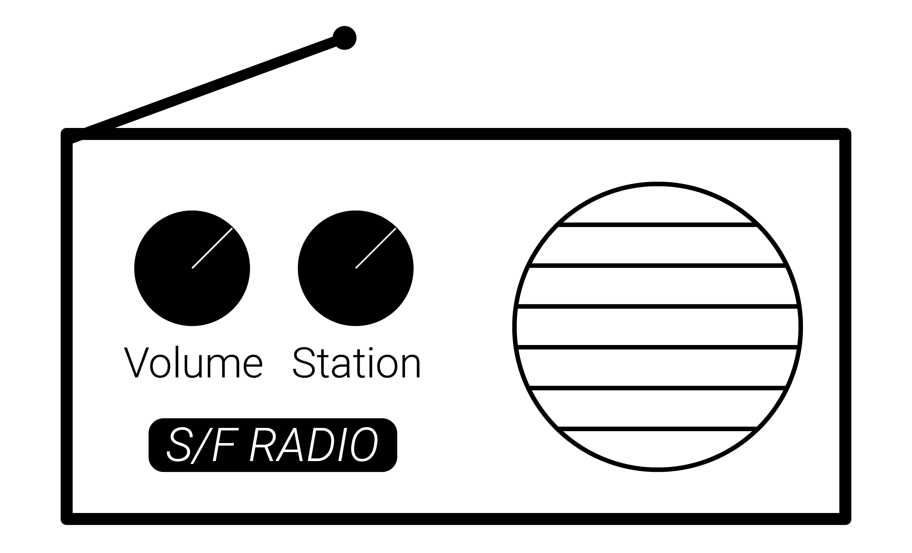
Modular Thinking: Systems & Signals
Case Study: Radio
Notes:
ASK THE AUDIENCE:
What are the ins and outs?
Are there different types?

Slide 9
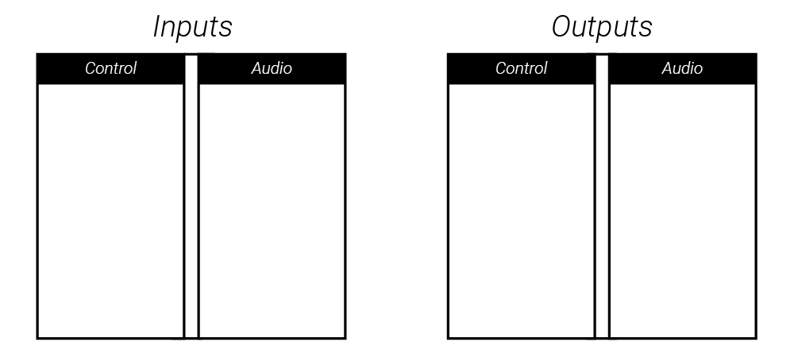
Modular Thinking: Systems & Signals
Case Study: Radio

Slide 10
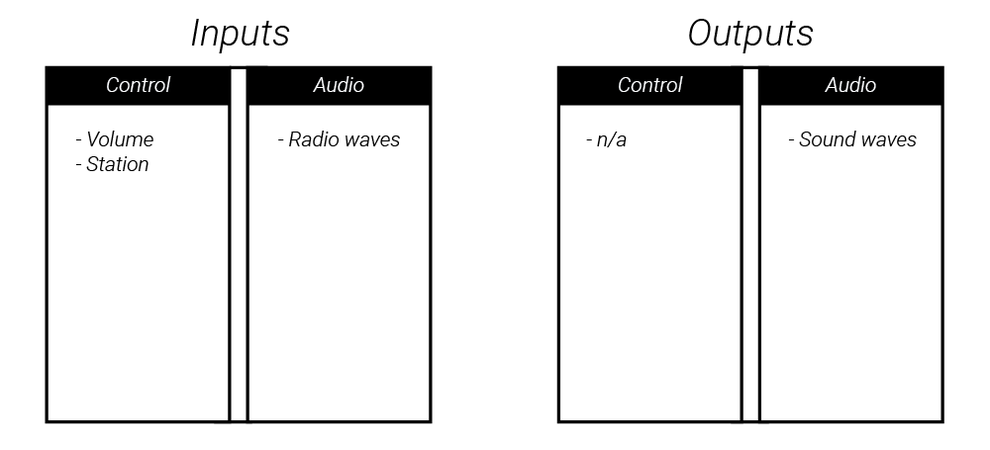
Modular Thinking: Systems & Signals
Case Study: Radio

Slide 11
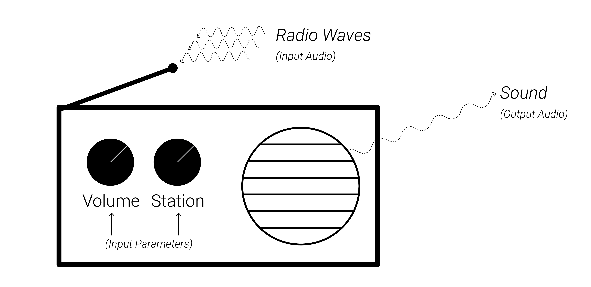
Modular Thinking: Systems & Signals
Case Study: Radio

Slide 12
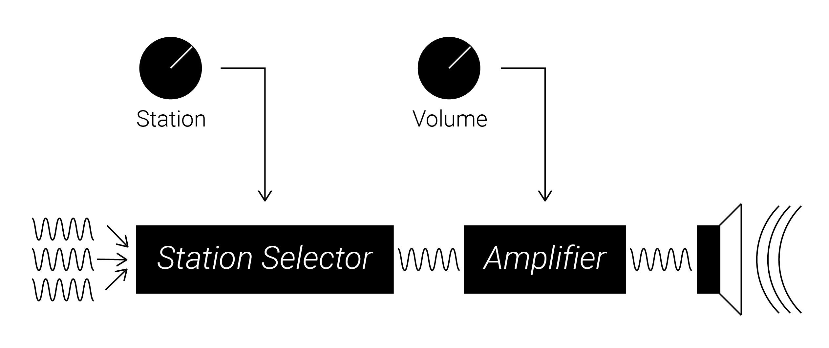
Modular Thinking: Systems & Signals
Case Study: Radio

Slide 13
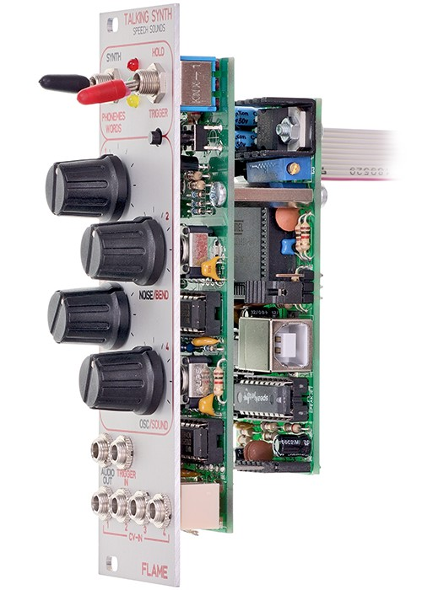
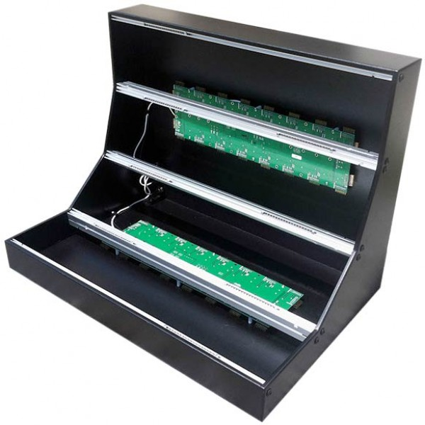
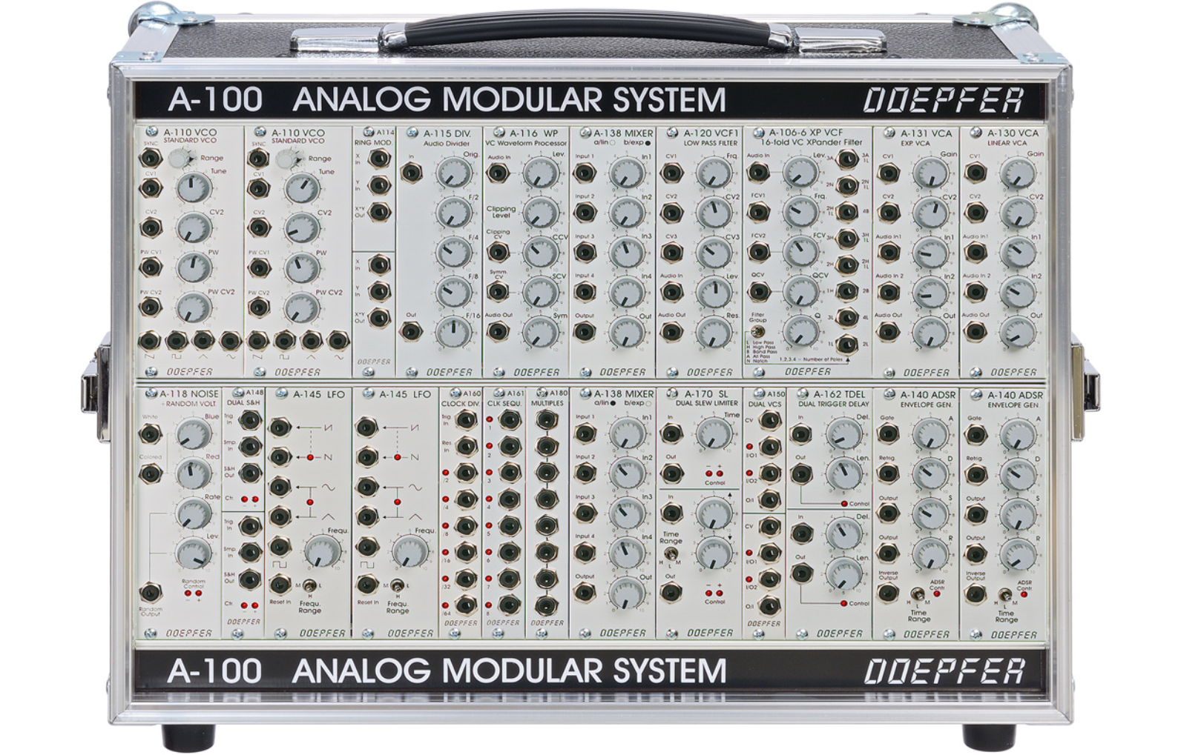
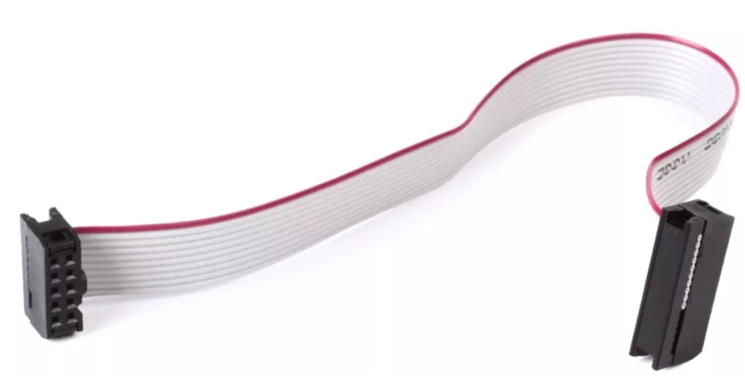
Modular Thinking: Patching
A module is a device that accepts input signals and produces an output based off the input signals according to its own set of rules.
A rack is a collection of modules all installed into a single case with a shared power source.
Eurorack is a specific standard for the sizing, power needs, and voltage levels of a module so that many designers modules can all be used together in the same case.

Slide 14
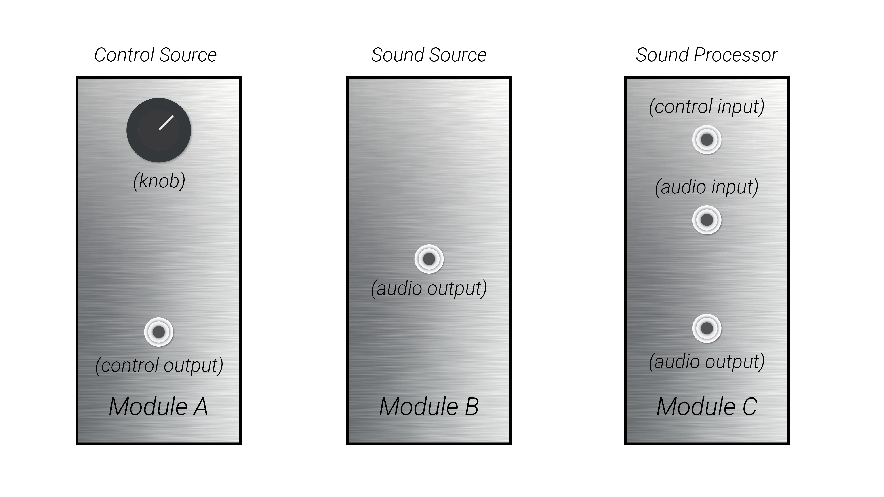
Modular Thinking: Patching
Generic Types of Modules:
Sound Generators
Sound Processors
Control Voltage Generators
Control Voltage Processors

Slide 15
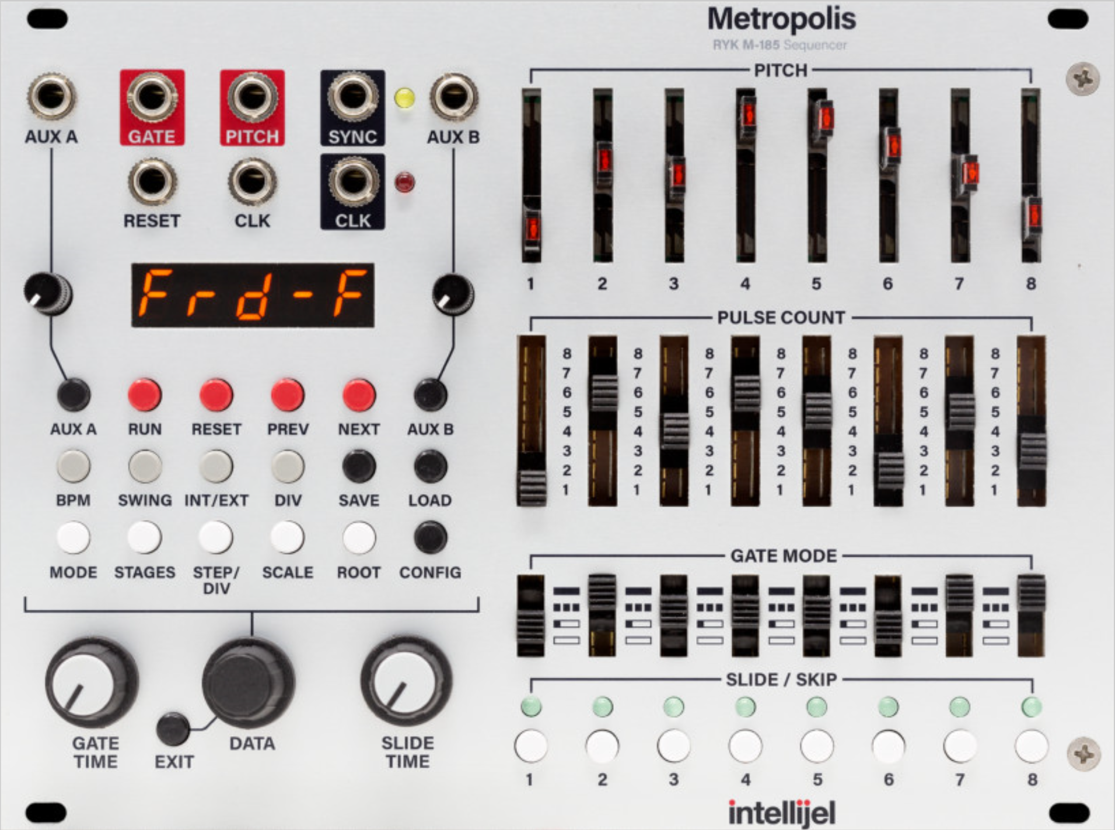
Modular Thinking: Patching
Notes:
ASK THE AUDIENCE:
How do you think you might interact with this?

Slide 16
Modular Thinking: Patching
Interface:
Interactive Objects (Knobs, Sliders, Buttons, Switches, etc)
Information Feedback: LEDs, Screens, Text/Graphics
Signal Inputs
Signal Outputs
Notes:
ASK THE AUDIENCE:
How do you think you might interact with this?

Slide 17
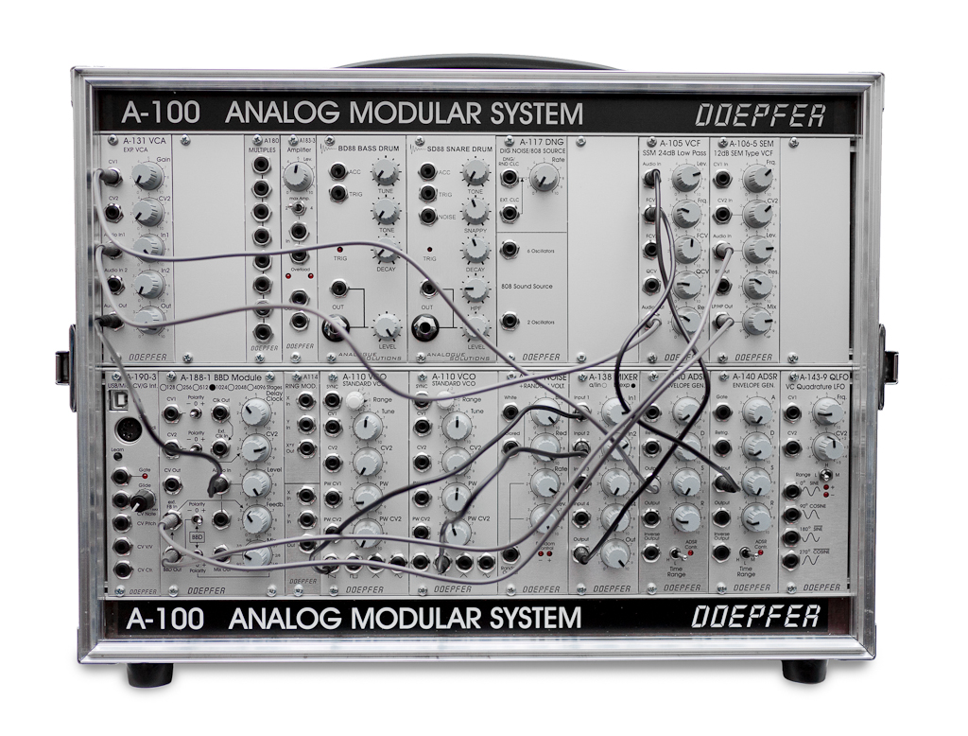
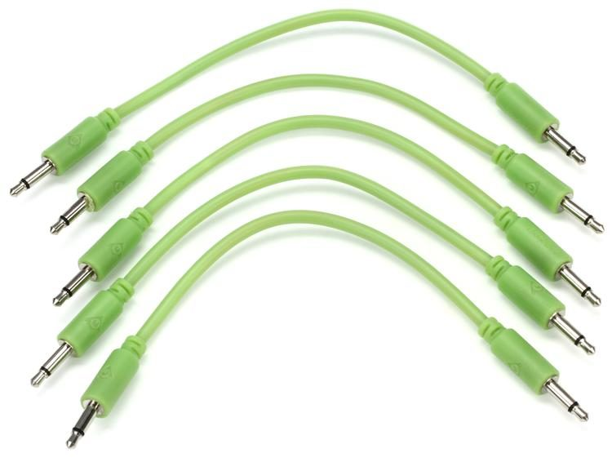
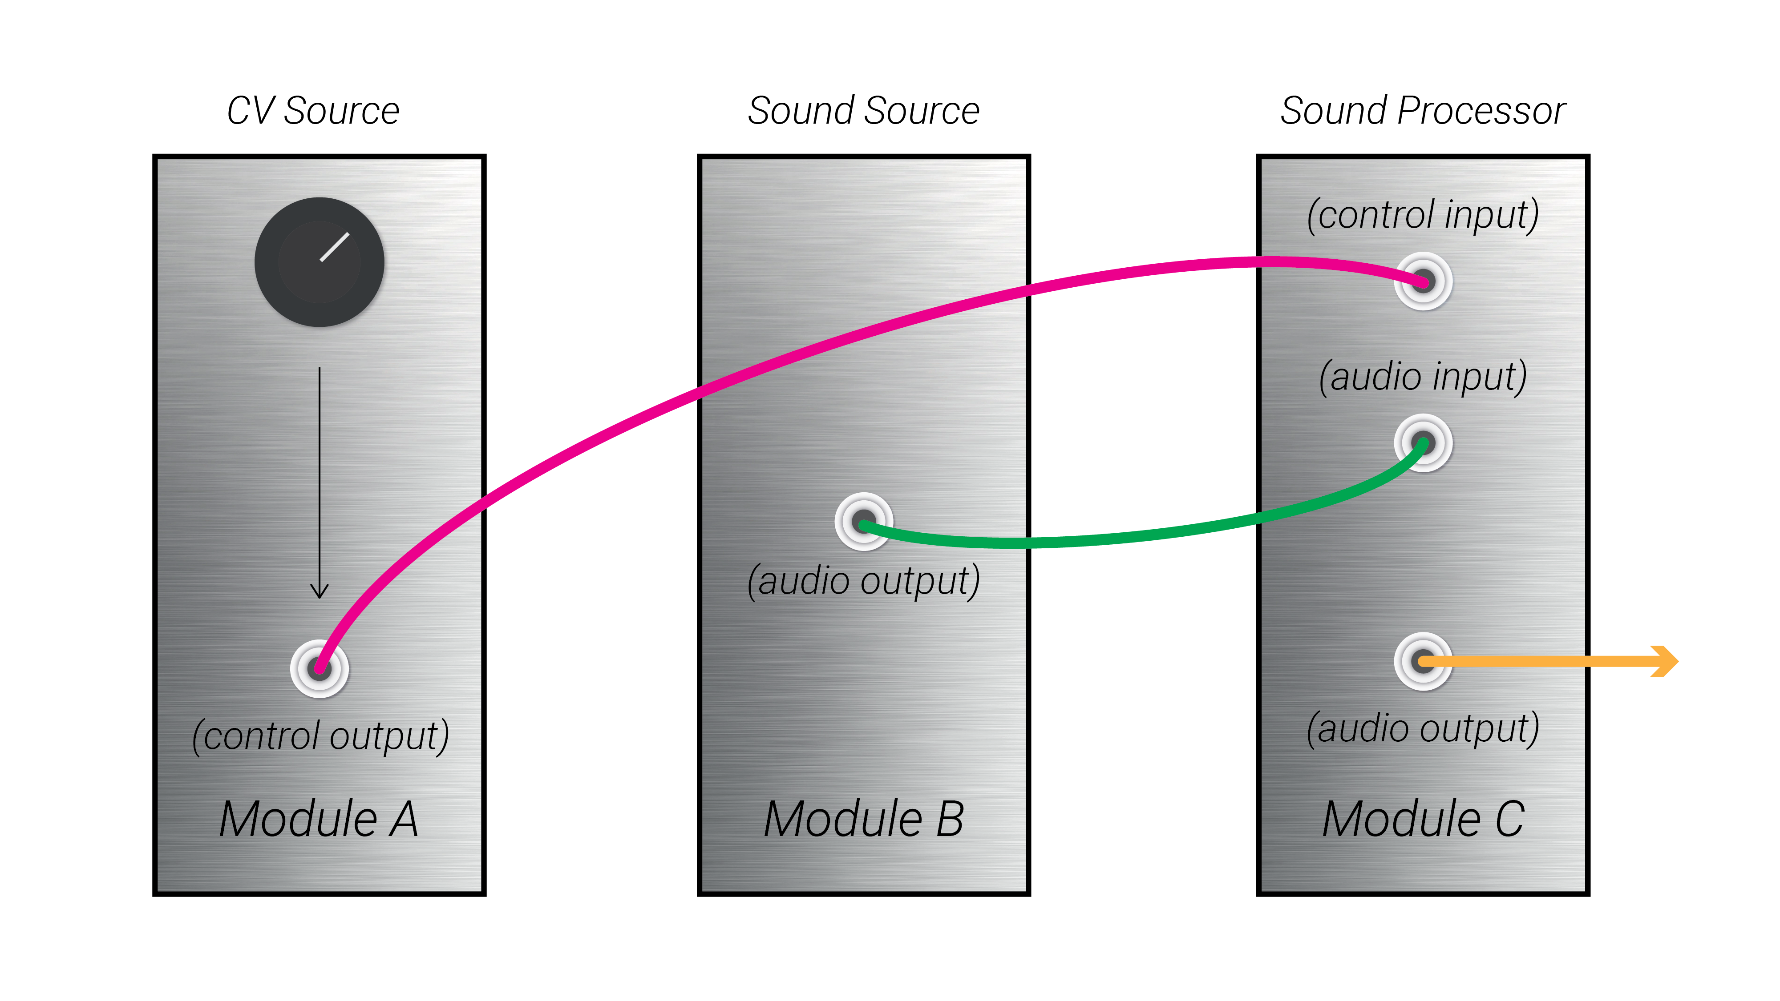
Modular Thinking: Patching
Cables carry signals from the output of one module to the input of another module
Signals may be audio for processing
Signals may be control voltage used to modify parameters on another module
Composing or improvising with a modular synthesizer is the act of creating and interacting with patches

Slide 18
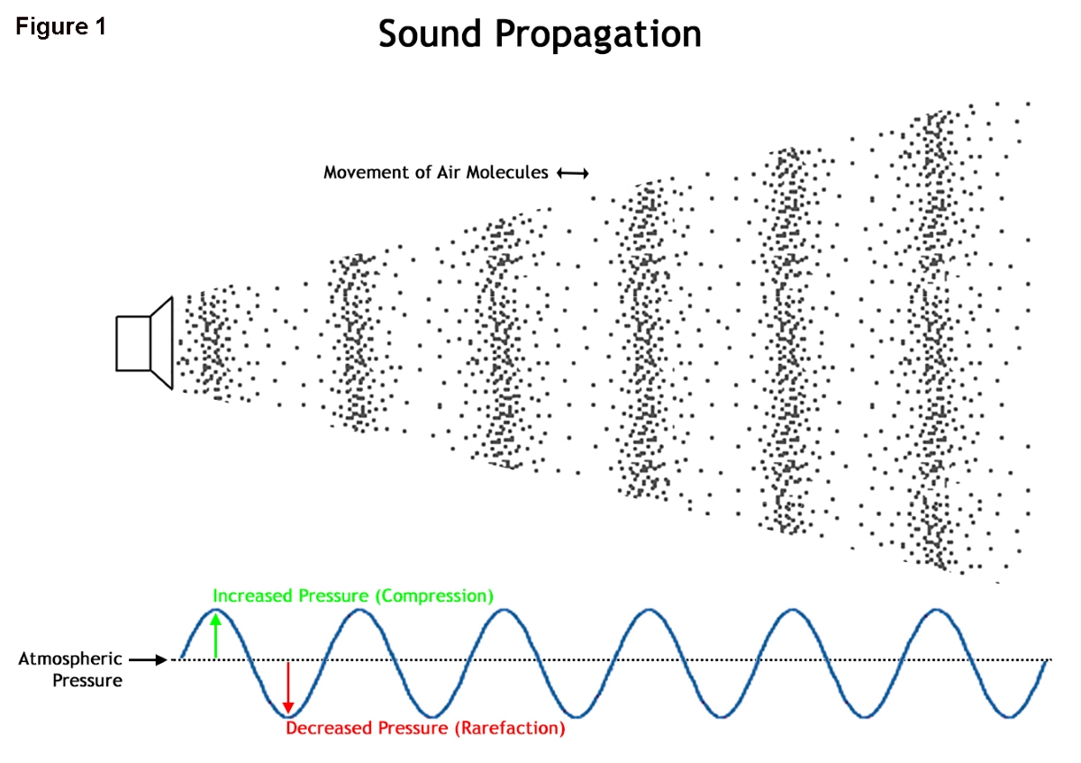
What is sound?
Notes:
ASK THE AUDIENCE:
What is sound/

Slide 19
What is sound?
The phenomenon of Sound is created by air pressure waves reaching our ears.
Notes:
ASK THE AUDIENCE:
What is sound/

Slide 20
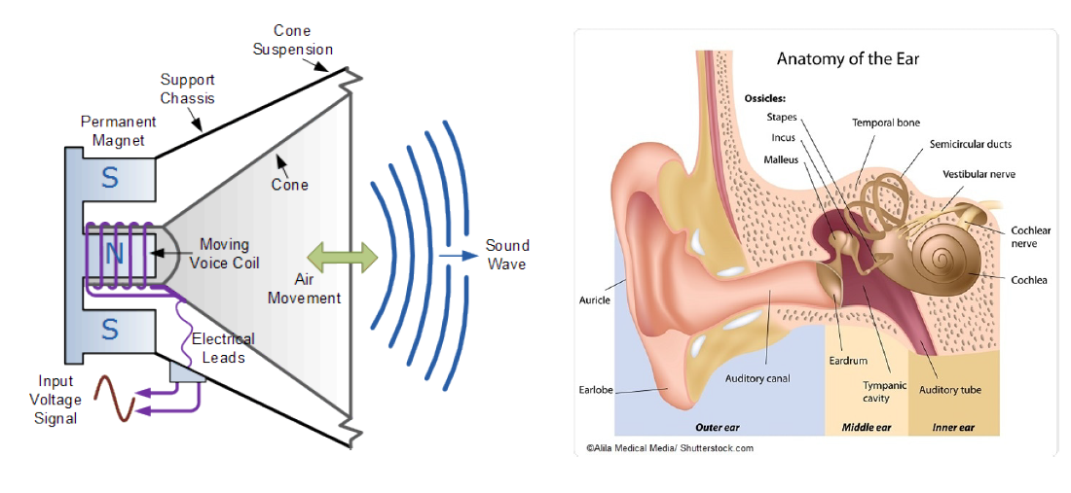
The Physics of Sound
Synthesizers generate the voltage to push the speaker cone, and thus create sound!
Electrical voltages are used to push the speaker cone back and forth.
Speaker cones push air back and forth, creating air pressure waves.
Air pressure waves reach the ear and are heard as sound.

Slide 21
The Parameterization of Sound
Notes:
ASK THE AUDIENCE:
What are the different parameters of sound?
Demo two different pitches, or maybe a sequence of pitches, even a chord from JF maybe

Slide 22
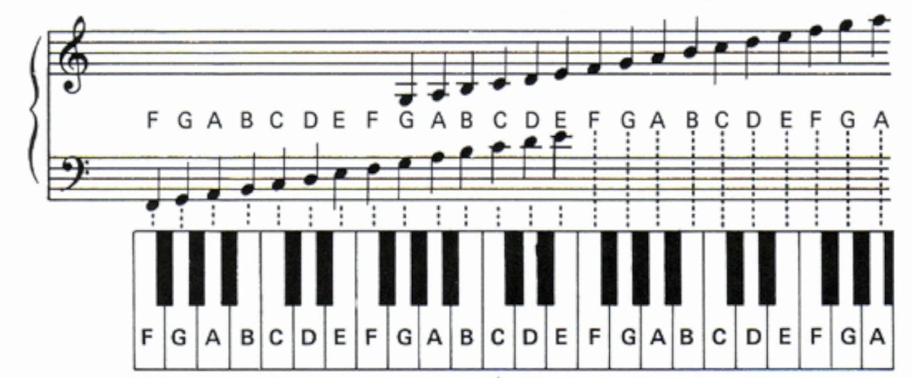
The Parameterization of Sound
Pitch:
How high or low a sound is
Melodies are made out of sequences of different pitches
Harmonies and chords are composed of multiple voices producing different pitches that sound pleasing together
Notes:
ASK THE AUDIENCE:
What are the different parameters of sound?
Demo two different pitches, or maybe a sequence of pitches, even a chord from JF maybe

Slide 23
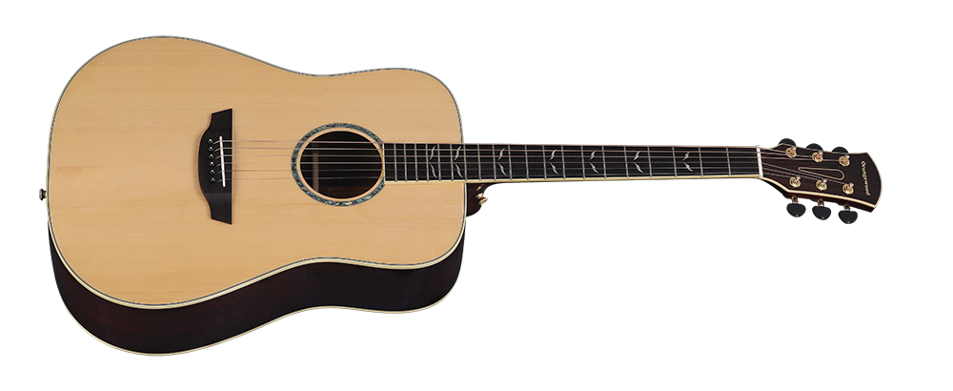
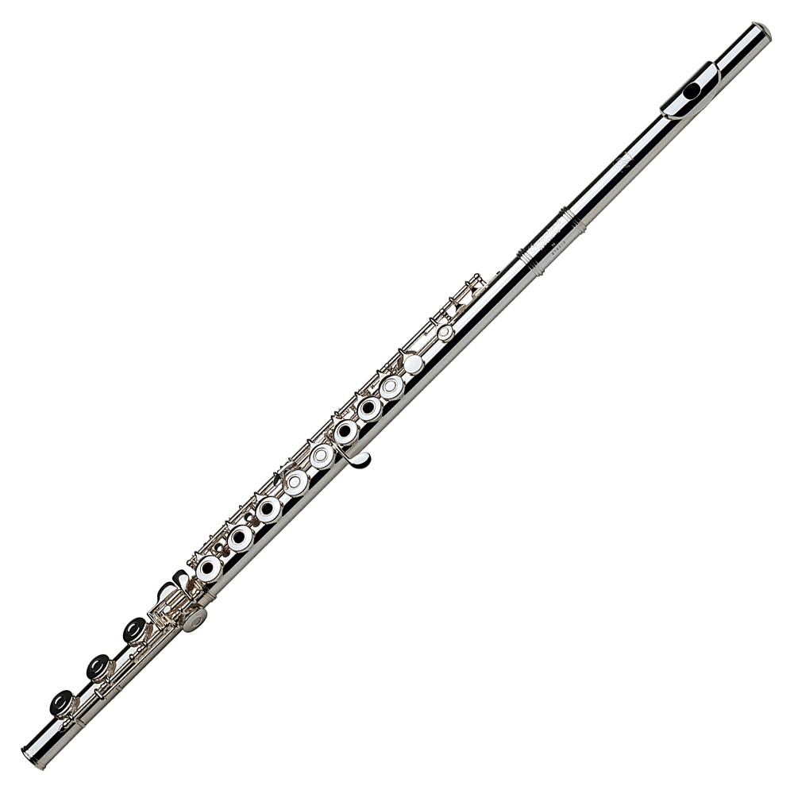
The Parameterization of Sound
Timbre:
The “character” of a sound;
The difference between the same pitch played by two different instruments is their timbre
Notes:
Play e.g. a sawtooth wave vs a sine wave

Slide 24
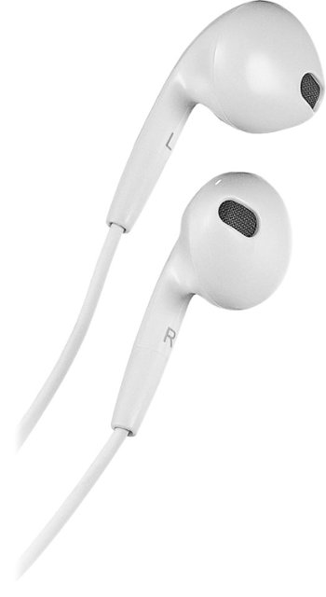
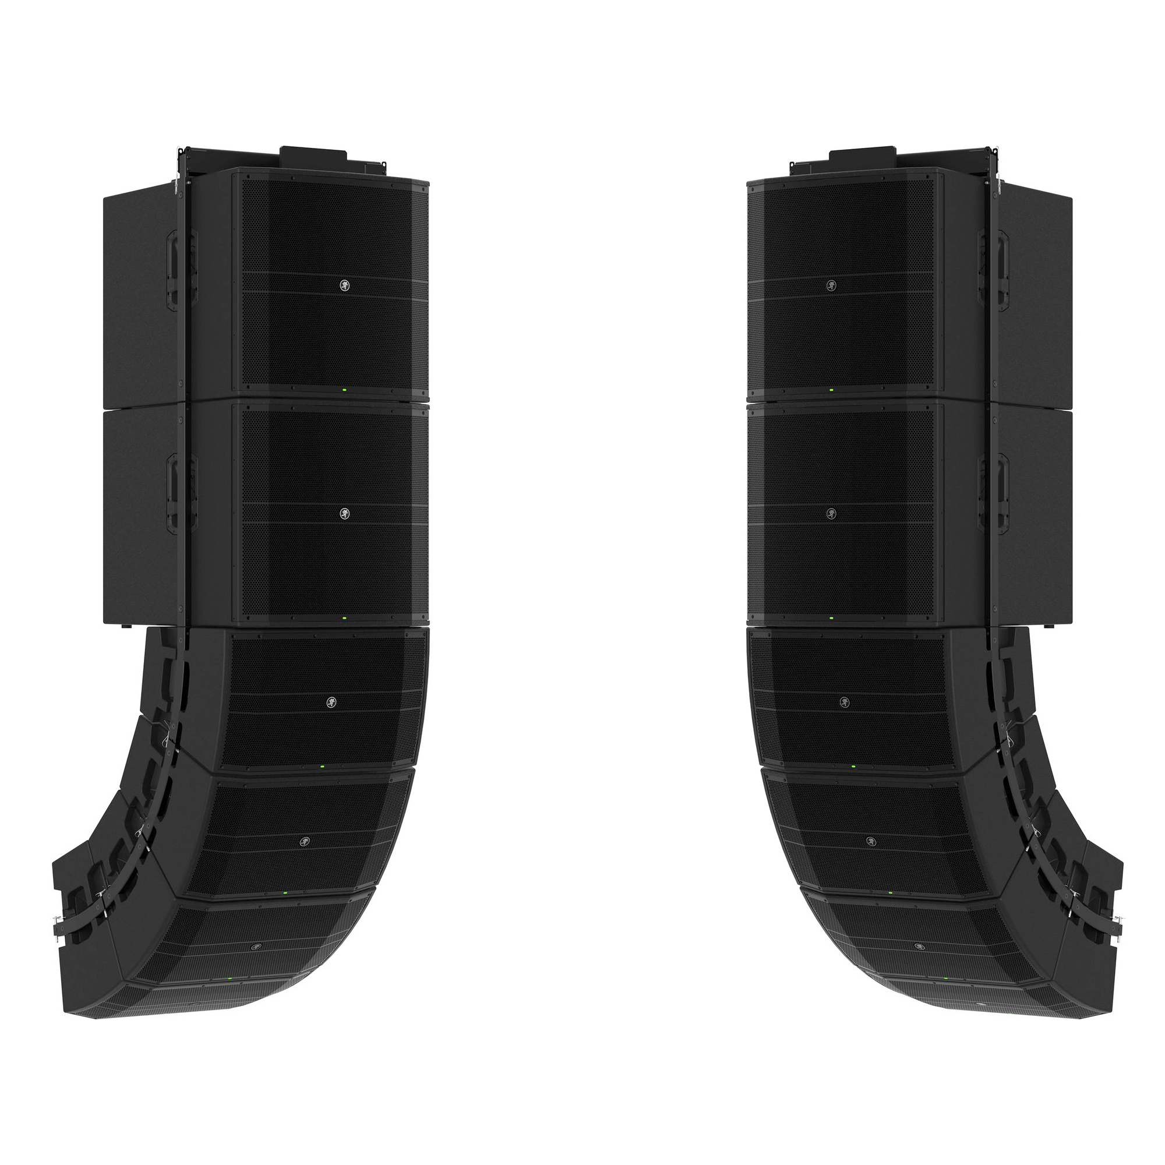
The Parameterization of Sound
Loudness:
The “intensity” of a sound
Greater sound pressure waves creates more intense ear drum movement, and a “louder” sound
Earbuds can produce sound waves only at a very quiet level, while a line array can play back the same sounds at an enormously louder level
Notes:
Change the volume of a sound (maybe once with an OSC, and once with Radio Music)

Slide 25
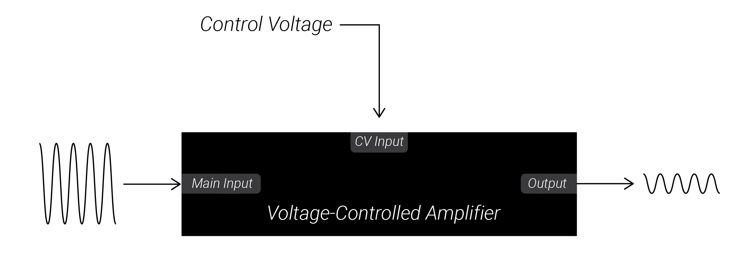
The Parameterization of Sound
Control Voltage/Modulation:
Using a slowly changing or constant signal from one module to change the parameters of another module
Notes:
Demonstrate an LFO, a sequence, and an envelope, maybe do 2-3 examples with an oscillator and one example with radio music.

Slide 26
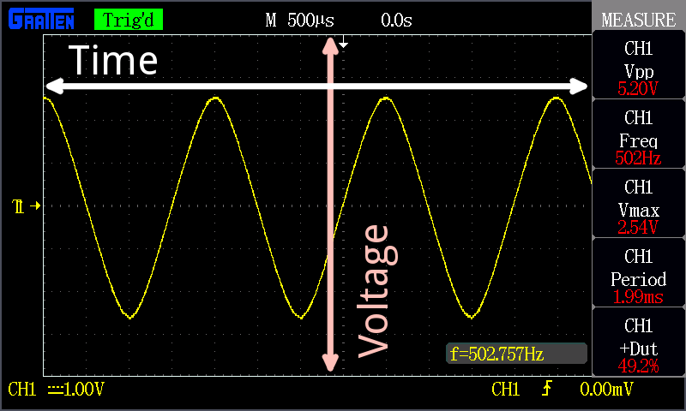
Oscillscopes, Voltage & Signals
Electrical signals are measured in voltage.
Magnitude corresponds to how large the voltage is (i.e. how far from 0V it is).
Polarity means whether the voltage is positive or negative.
Oscilloscopes show how signals change over time.

Slide 27
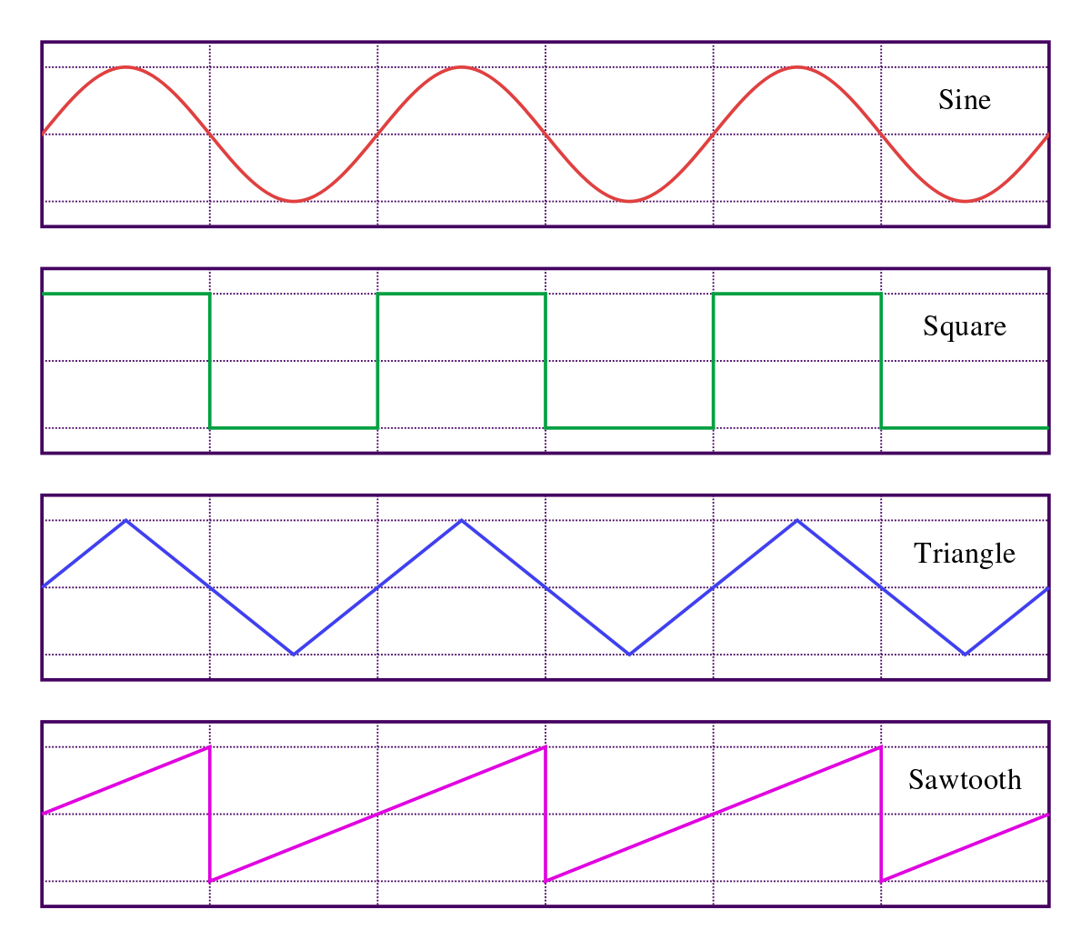
Oscillators
Oscillators create voltages which moves up and down in a pattern.
The shape of the repeating pattern is known as the “waveshape.”

Slide 28
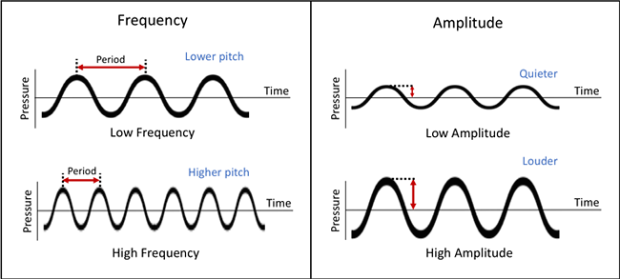
Oscillators
Period: the time it takes to complete one cycle of the pattern.
Frequency: the number of cycles completed per second, and is measured in Hertz (Hz)
Hertz (Hz): 1Hz = 1 cycle completed per second
If the frequency is greater than 20Hz, the oscillating voltage can be used to drive a speaker cone back and forth creating pitched sound waves. Higher frequencies correspond to higher pitches.

Slide 29
Oscillators
Amplitude: the difference between the largest (peak) and lowest (trough) voltage the oscillation reaches.
Peak-to-peak voltage (Vpp): Voltage difference between peak and trough
For audio-rate oscillations, the amplitude of the oscillation corresponds to its loudness: greater amplitude means louder sound.

Slide 30
Oscillators
Waveshape: the pattern an oscillator follows as it rises and falls
The waveshape of an audio-rate oscillator determines its timbre.
Sine waves are the “purest”, simplest sound.

Slide 31
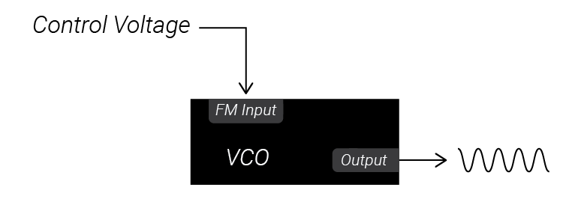
VCOs & LFOs
<scope placeholder>
Voltage-controlled Oscillators (VCOs) are oscillators whose frequency can be controlled by external control voltage.
Low-Frequency Oscillators create oscillations which are too slow to be used as sound but can be used instead to controls parameters of another module, like the frequency of another VCO.
Frequency input jacks are often labeled “FM Input” for “frequency modulation.”

Slide 32
Attenuators, Inverters & Attenuverters
<scope placeholder>
Attenuator: Changes the amplitude of an incoming signal without changing the shape of it in time. Vertically stretches/shrinks a voltage
Inverter: Flips the polarity of an incoming voltage but leaves the magnitude unaffected
Attenuverters: Similar to an attenuator, but it can also invert voltages before attenuating them.
Attenuators and Attenuverters generally scale the incoming voltage proportionally to the knob position. This allows us to control the depth of modulation by a given control voltage signal.

Slide 33
VCAs
<scope placeholder>
Voltage-Controlled Amplifiers: Similar to attenuators, but instead of using a knob to set the attenuation, a VCA checks its control voltage input to set the attenuation of another incoming signal. The higher the control voltage input, the greater the amplitude of the signal output.
VCAs can be used to control the volume of an audio signal.
VCAs can also be used to control the modulation depth of another CV signal.

